Slide 1

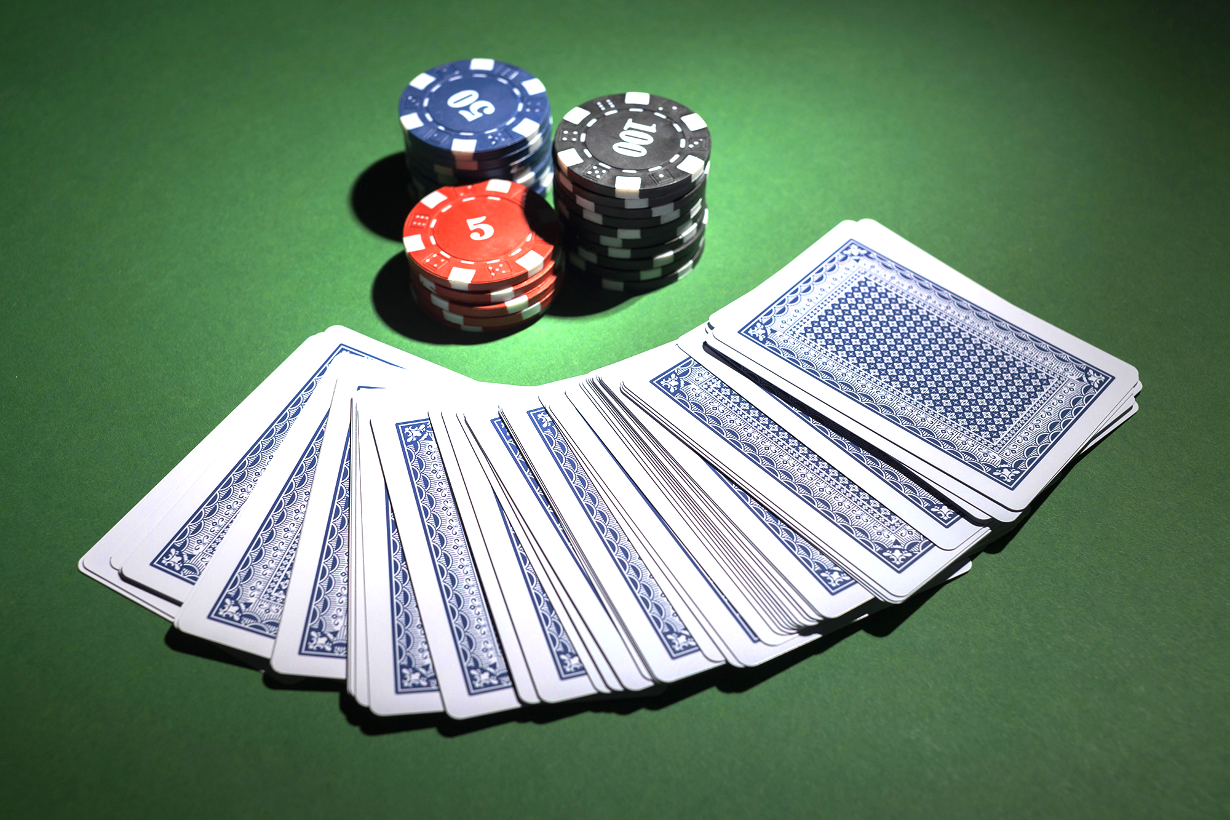
POKER CARD CLASSIFICATION AND VISUALIZATION
Students: Luka Chabaud, Manuel Parma & Joel Duran
Course: Deep Learning 2023

Slide 2
OVERVIEW
Objective
Dataset
Hyperparameters
Recognition Models
Multiple Cards Detection
6. Results
7. Possible
Solutions/Improvements
8. Conclusions

Slide 3
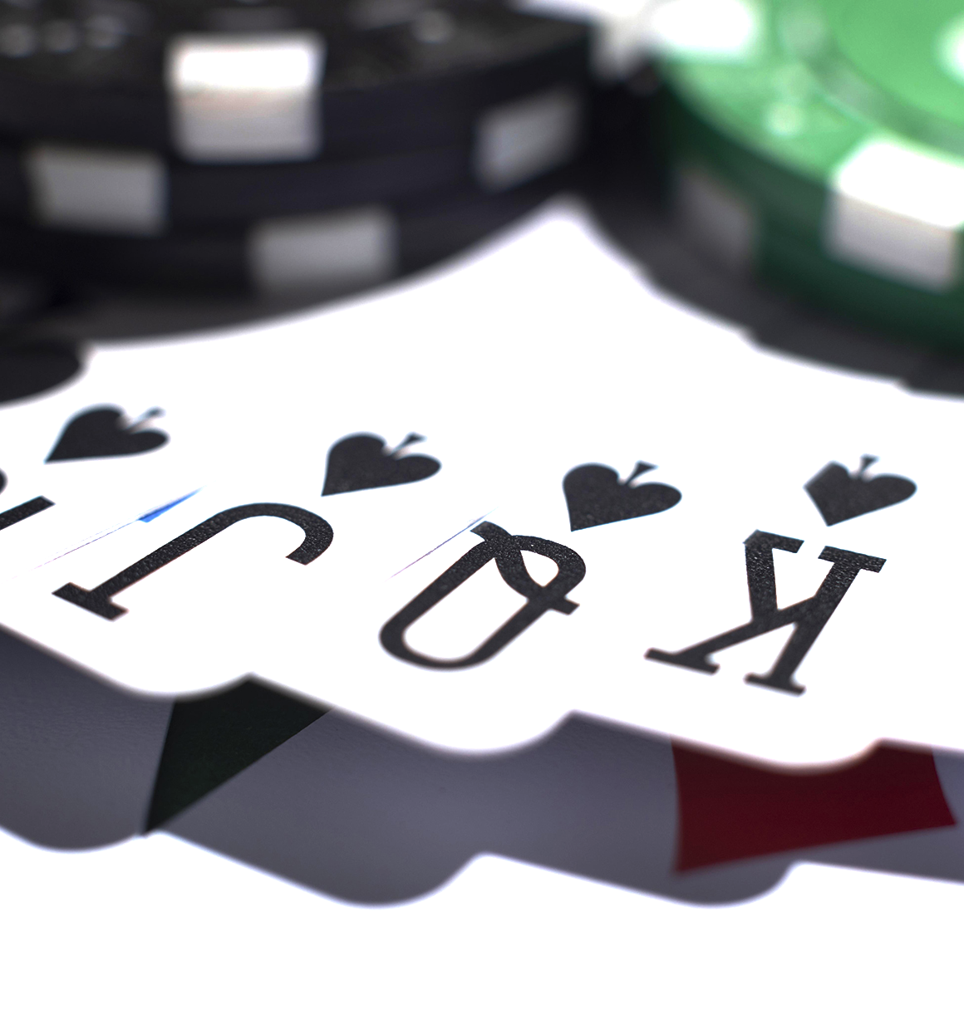
Objective
Build a Convolutional Neural Network (CNN) that is able to classify cards from an english deck into the corresponding class. Then given an image with several cards:
Locate them
Identify them
Recognize the hand
Tell a user possible playing actions

Slide 4
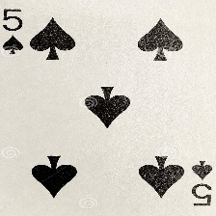
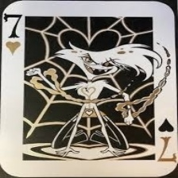
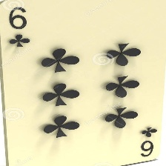
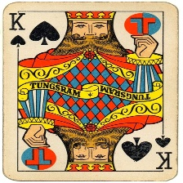
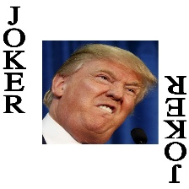
Dataset: Poker Cards
Obtained from Kaggle: Cards Image Dataset-Classification.
53 classes: 13 numbered cards for each of 4 suits, and a Joker card.
8154 samples in total:
7624 train
265 test
265 validation
Size: 224x224x3
.jpg format

Slide 5
Hyperparameters Configuration
10 epochs (or less if progress is stuck).
Learning rate: 0.001
Categorical Cross Entropy loss calculation.
Adam optimizer: gives good performance as seen in previous practice.
Weight Decay regularization: 0.001
Data batch size: 50 or 256 depending on trainable model size.

Slide 6
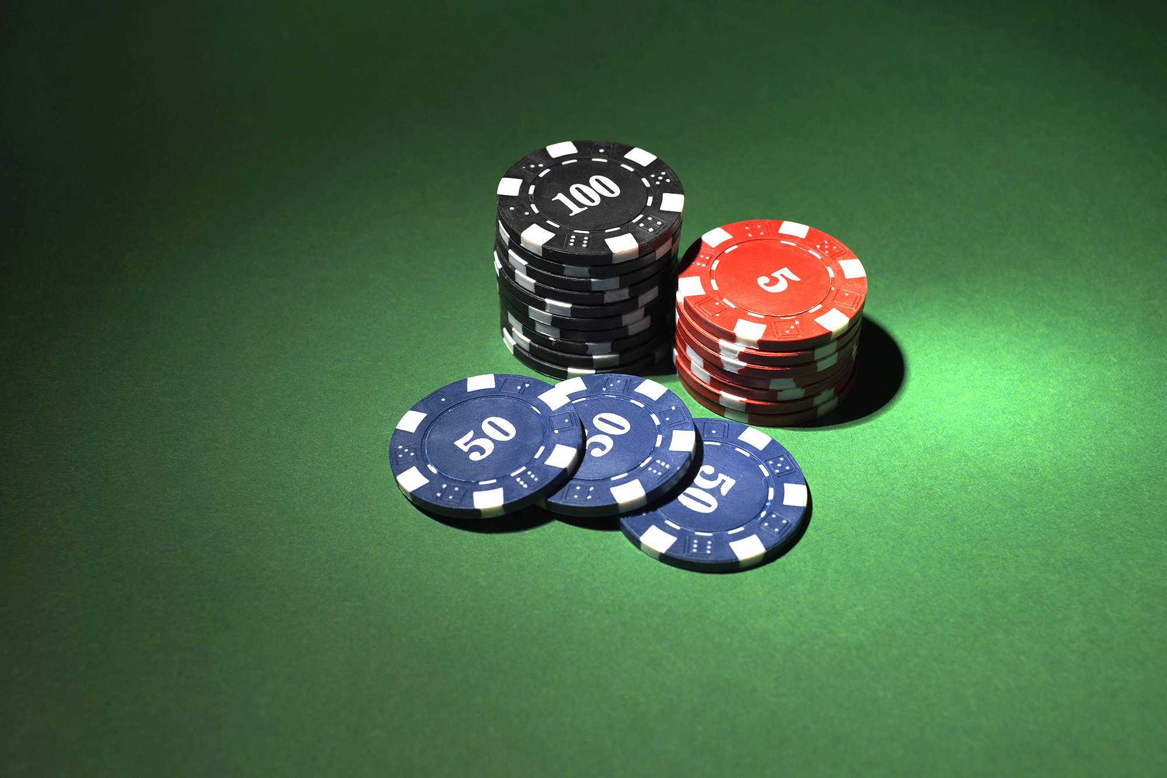
Recognition Models

Slide 7
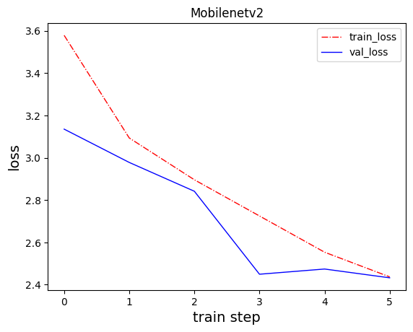
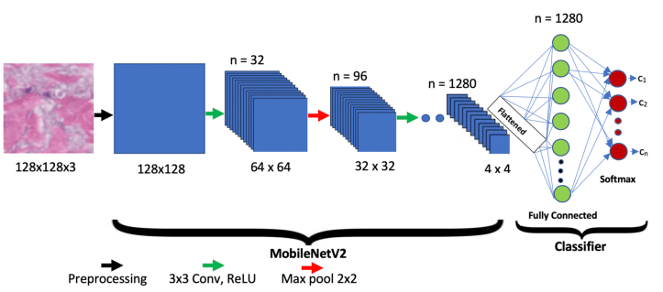
Model 1: MobileNetv2
Implemented in Practice 3.
53 layers using “Linear Bottlenecks”.
Gave good results for SVHN database (10 classes and few samples).
With Poker cards (53 classes): only 22.26% validation accuracy.
Max accuracy arrived at epoch 4 and stuck there.

Slide 8
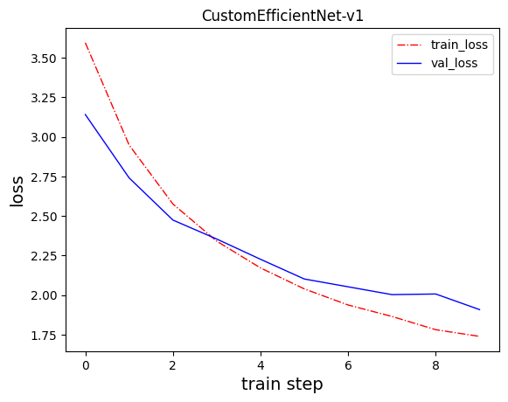

Model 2: EfficientNet b3 (Linear Classifier)
We decided to use transfer learning.
EfficientNet b3 was widely used in examples we saw online.
Pre-trained with ImageNet weights for classifying 1000 classes.
Classifier layer (last layer) was changed to a fully connected linear layer (to be trained) outputting our 53 classes.
Results improved but still suboptimal: only 42.26% validation accuracy.

Slide 9
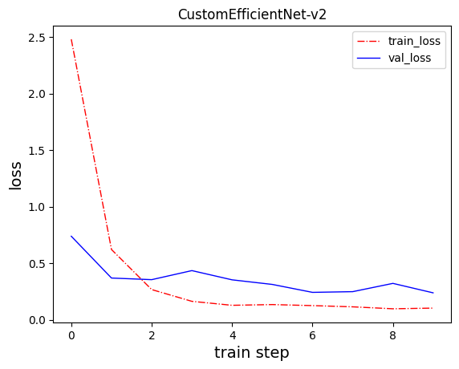
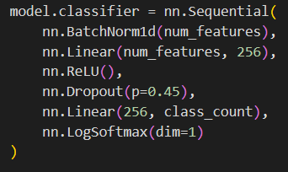
Model 3: EfficientNet b3 (Deeper Training)
We decided to further improve our EfficientNet b3 implementation based on examples online.
Classifier layer is now deeper: two fully connected linear layers.
Dropout regularization in between to avoid overfitting.
Transfer learning was expanded: we trained half of the model layers, not only classifier.
Results greatly improved: 94.72% validation accuracy!

Slide 10
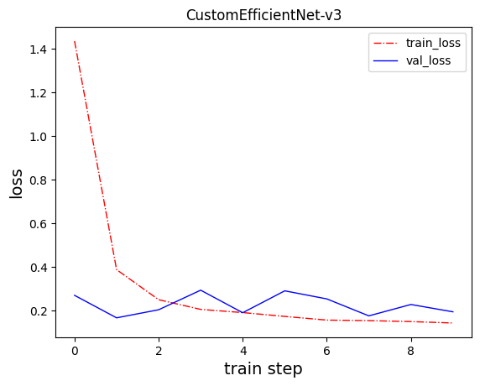
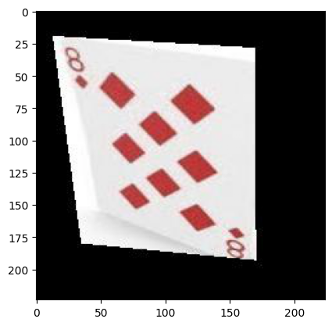
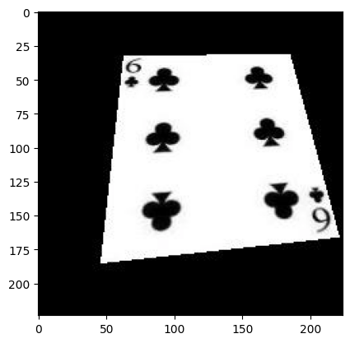
Data Augmentation + Model 3
To try and get the best result as possible, we decided on running model 3 with augmented data.
We applied RandomPerspective to all training samples twice.
This transformation was decided as real card images might not be perfectly centered in frame.
Got a small improvement: 95.10% validation accuracy
We decided this result was good enough as it surpassed the 95% accuracy mark.

Slide 11
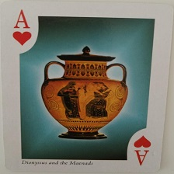
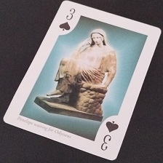
Test & Real Evaluation
Running the last trained model with the test dataset we obtained 93.2% accuracy.
To further test our model, we decided to take pictures of real unseen cards and test them.
For correctly centered and cropped images, the cards were correctly classified.
But, even with the transformed data, rotated/perspective cards do not give correct labels.
mode
“Ace of Hearts”
✔
mode
“Six of Hearts”
❌
Model
Model

Slide 12
Multiple Cards Detection

Slide 13
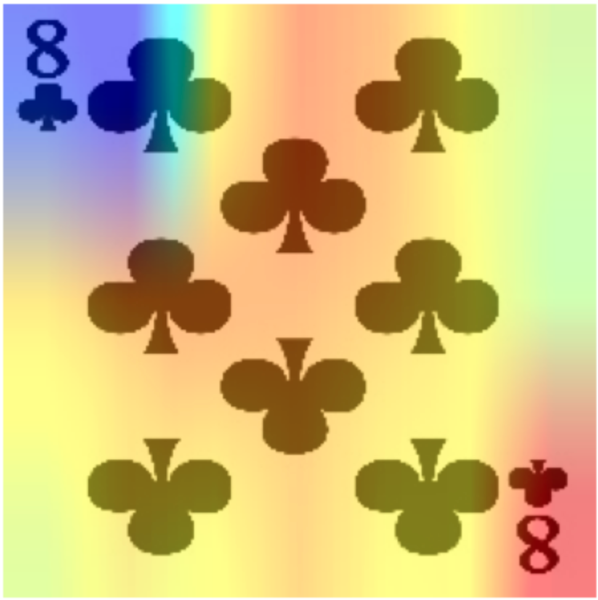
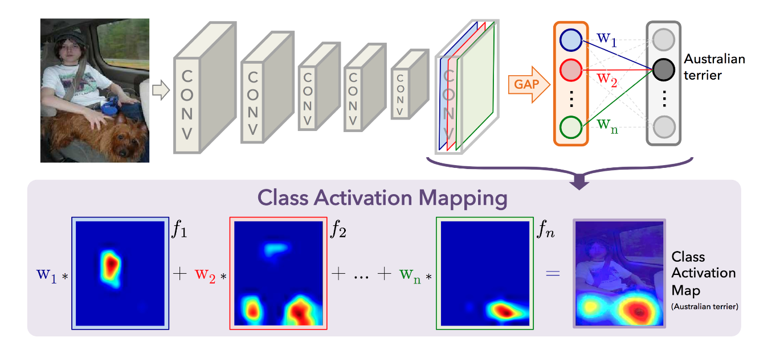
CAM Visualization
As a way to visualize where the model looks at, we can create Class Activation Mapping (CAM) heatmaps by multiplying each feature map by the corresponding weight and adding them altogether.
For that we need to add to our CNN:
Global Average Pool
Linear Layer

Slide 14
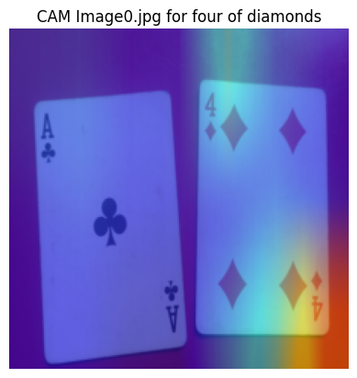
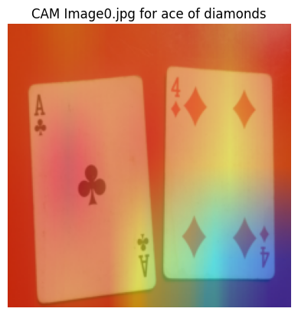
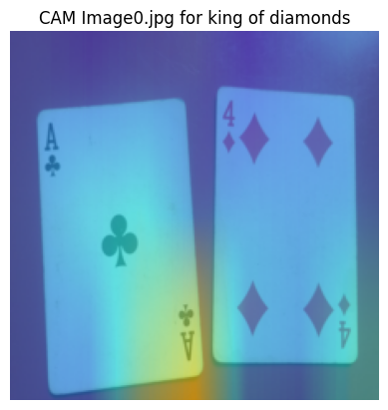
CAM Results
Works well for single card images as we can see that the corners are what identities a card.
For detecting multiple cards in an image, sometimes it might detect a single class, but not more than that.
“Four of Diamonds” (76.8%)
“Ace of Diamonds” (13.3%)
“King of Diamonds” (3.2%)

Slide 15
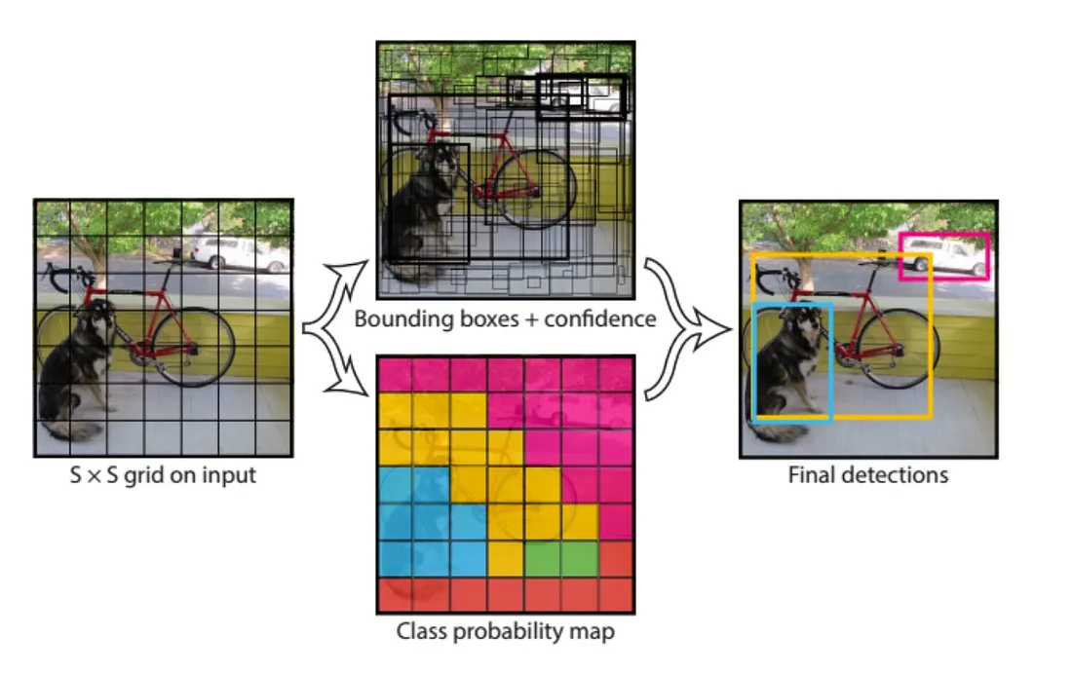
Possible Solutions/Improvements
Deeper and more complex N.N. for training the dataset, to achieve better accuracy (online examples showed at least 98%).
More suitable dataset with photos (instead of scans) of real poker cards.
YOLO (You Only Look Once) networks for multiple object (a.k.a. cards) detection.
Better platforms than Google Colaboratory.

Slide 16
Conclusions
During this project, we achieved:
High accuracy classification of 53 different types of cards (> 93%) with transfer learning.
Visualization of the CAMs through a heatmap.
We also faced some challenges, such as:
Difficulties in analyzing rotated cards.
Detecting several cards from a single image.
Meaning that our original objective is not achievable in this current state.

Slide 17
References
Abdallah Wagih Ibrahim. (2022, November 4). Effecientnetb3-cards-classification-98.85. Kaggle. https://www.kaggle.com/code/abdallahwagih/effecientnetb3-cards-classification-98-85/notebook
Cook, A. (2017, April 9). Global average pooling layers for object localization. Personal Blog. https://alexisbcook.github.io/2017/global-average-pooling-layers-for-object-localization/
Gerry. (2022, November 17). Cards image dataset-classification. Kaggle. https://www.kaggle.com/datasets/gpiosenka/cards-image-datasetclassification

Slide 18
Thank You!
Questions?
Students: Luka Chabaud, Manuel Parma & Joel Duran
Course: Deep Learning 2023

Slide 19
OTHER POKER VARIANTS
RAZZ
SEVEN-CARD STUD
FIVE-CARD DRAW
Mercury is the closest planet to the Sun and the smallest of them all
Venus has a beautiful name and is the second planet from the Sun
Despite being red, Mars is actually a cold place. It’s full of iron oxide dust

Slide 20
SOME POKER HANDS
A
K
Q
J
10
9
9
9
9
3
6
6
6
3
3
ROYAL FLUSH
FOUR OF A KIND (QUADS)
FULL HOUSE
Jupiter is the biggest planet of them all
Saturn is composed of hydrogen and helium
Venus is the second planet from the Sun
6
7
8
9
10
3
4
5
6
7
2
7
J
A
4
STRAIGHT FLUSH
STRAIGHT
FLUSH
Mercury is the closest planet to the Sun
Neptune is the farthest planet from the Sun
Despite being red, Mars is actually a cold place

Slide 21
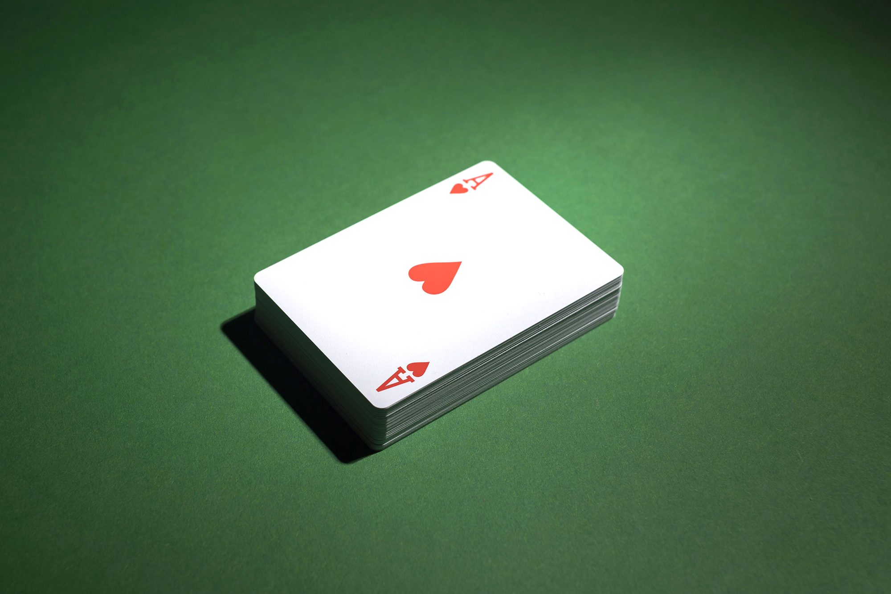
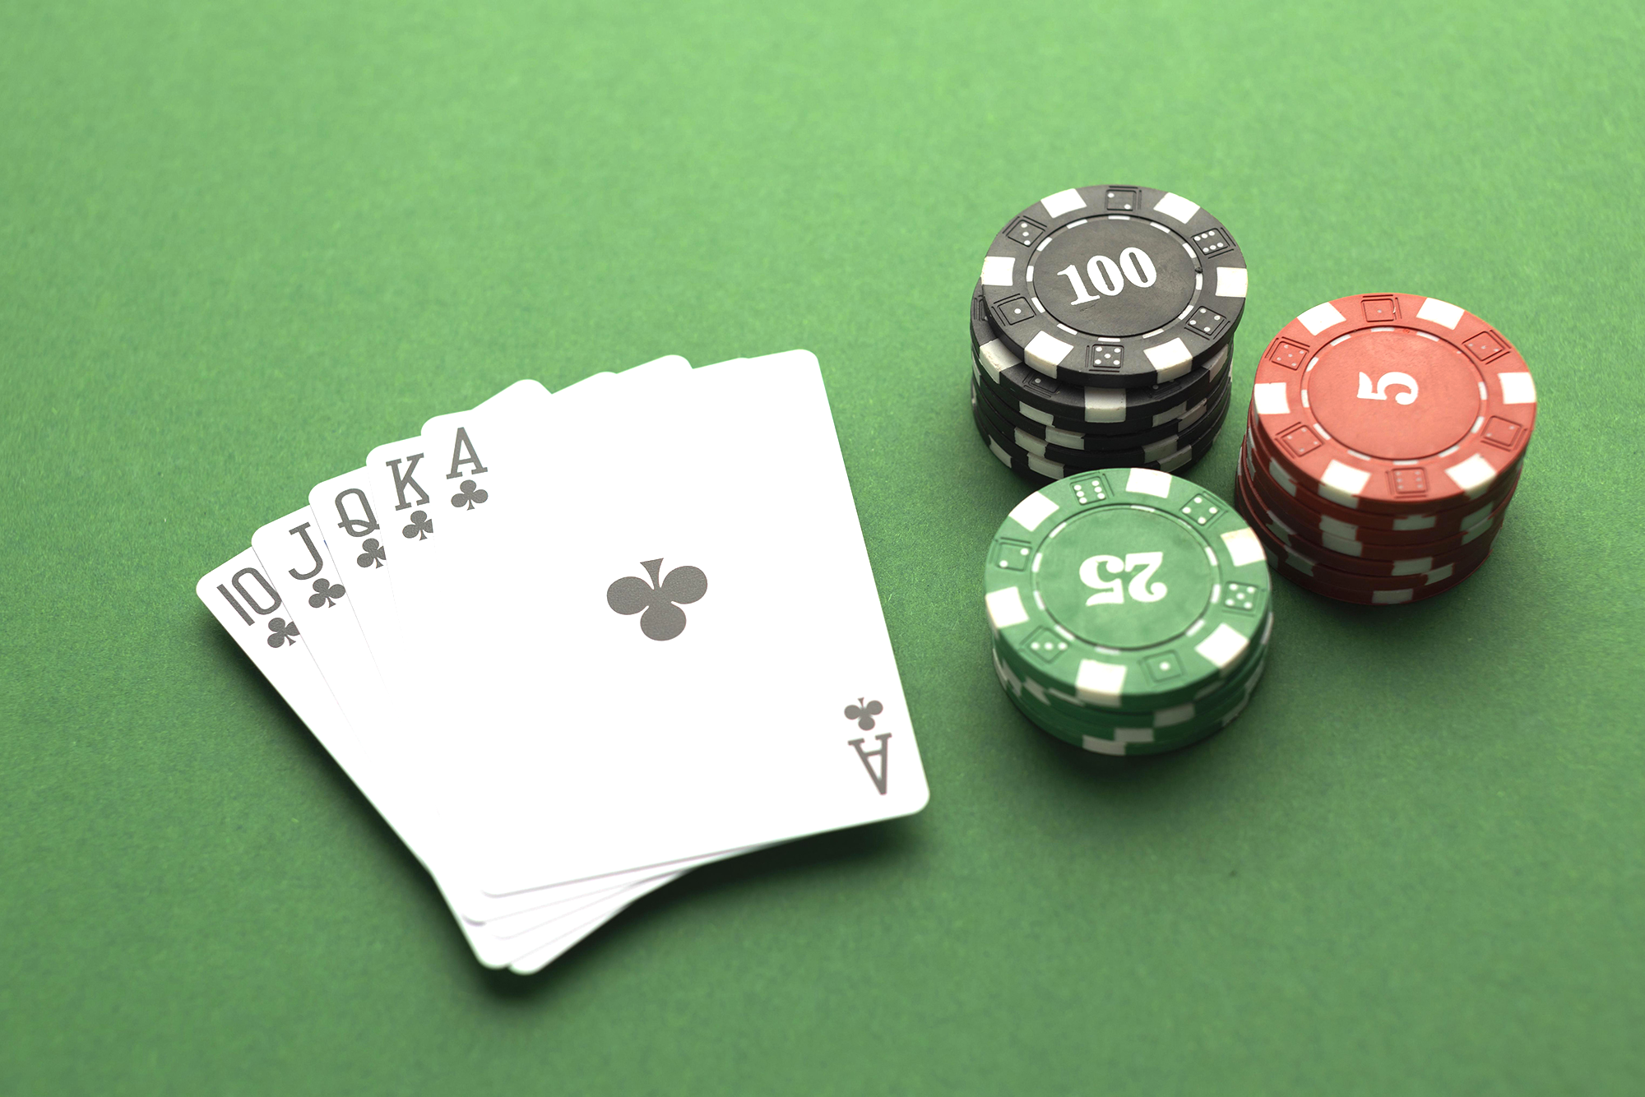
9H 55M 23S
333,000.00
386,000 KM
Jupiter's rotation period
The Sun’s mass compared to Earth’s
Distance between Earth and Moon

Slide 22
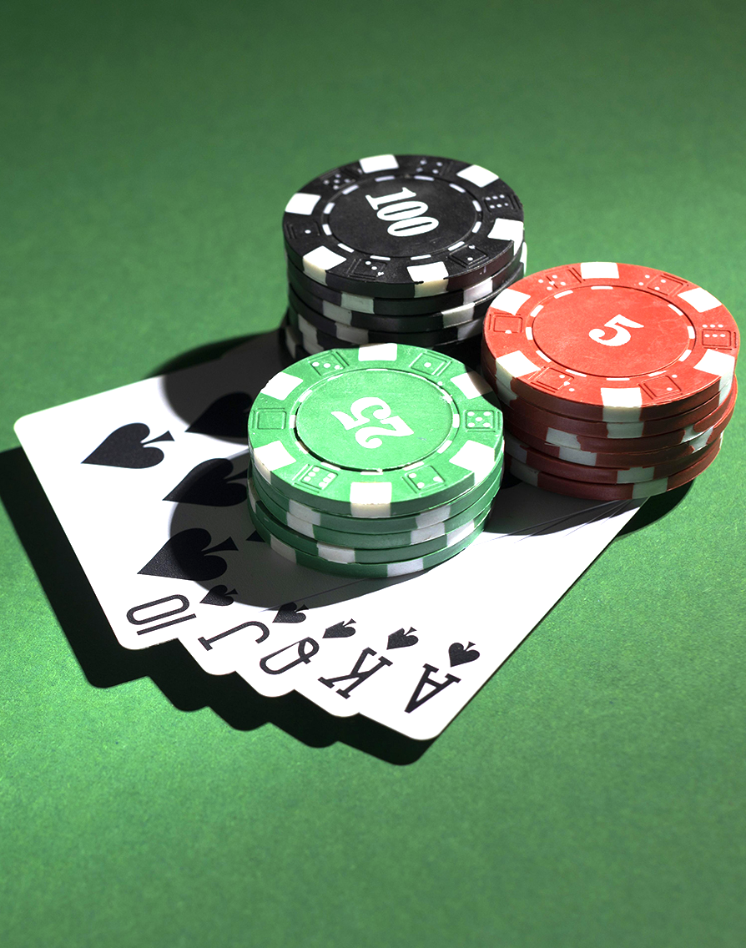
150,000
Big numbers catch your audience’s attention

Slide 23
AWESOME WORDS

Slide 24

A PICTURE ALWAYS REINFORCES THE CONCEPT
Images reveal large amounts of data, so remember: use an image instead of a long text. Your audience will appreciate it

Slide 25
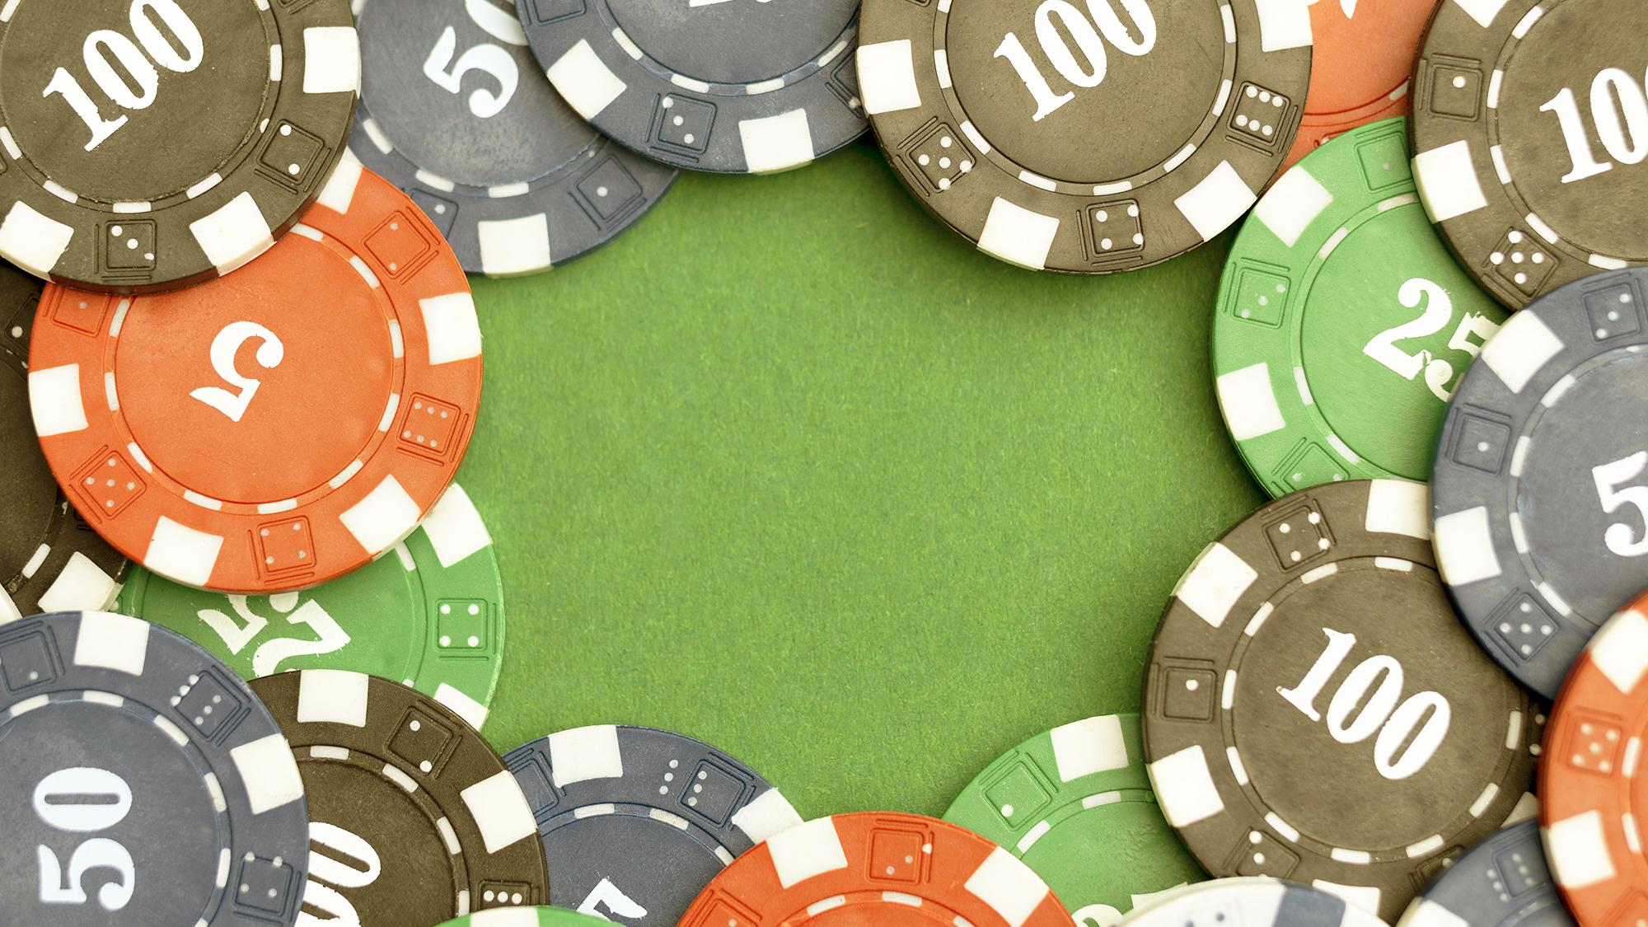
A PICTURE IS WORTH A THOUSAND WORDS

Slide 26
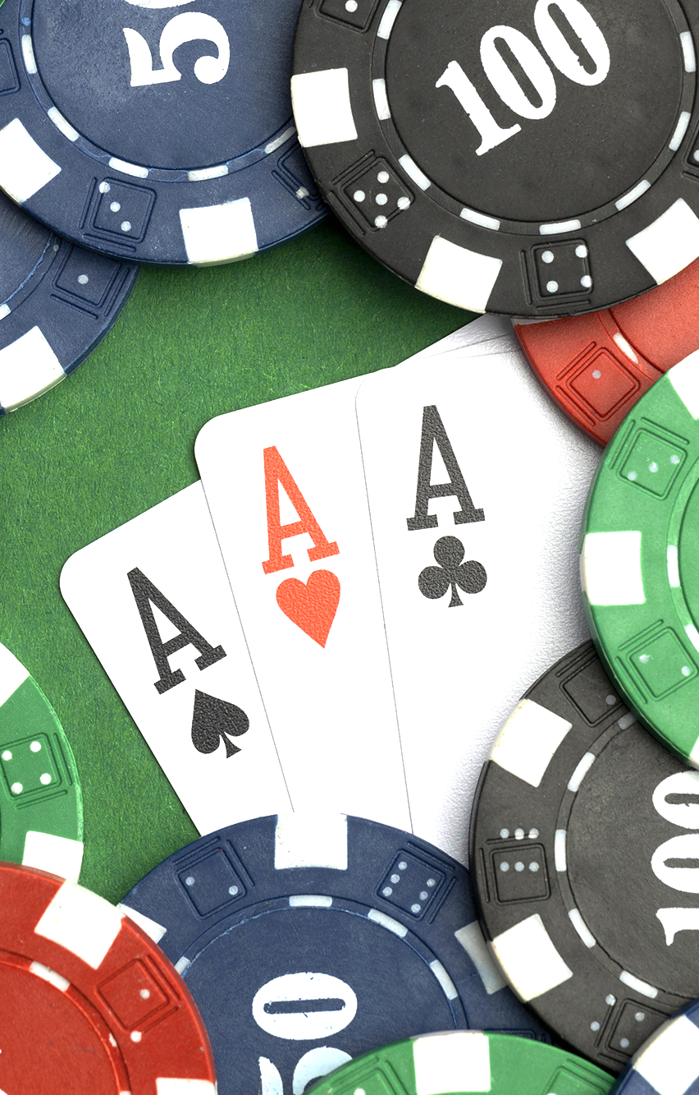
—SOMEONE FAMOUS
“This is a quote, words full of wisdom that someone important said and can make the reader get inspired”

Slide 27
MAJOR TOURNAMENTS
AUSTRALIAN
ATLANTIC CITY
CARIBBEAN
Jupiter is the biggest planet of them all
Venus is the second planet from the Sun
ASIAN
Mercury is the closest planet to the Sun
Despite being red, Mars is a very cold place

Slide 28
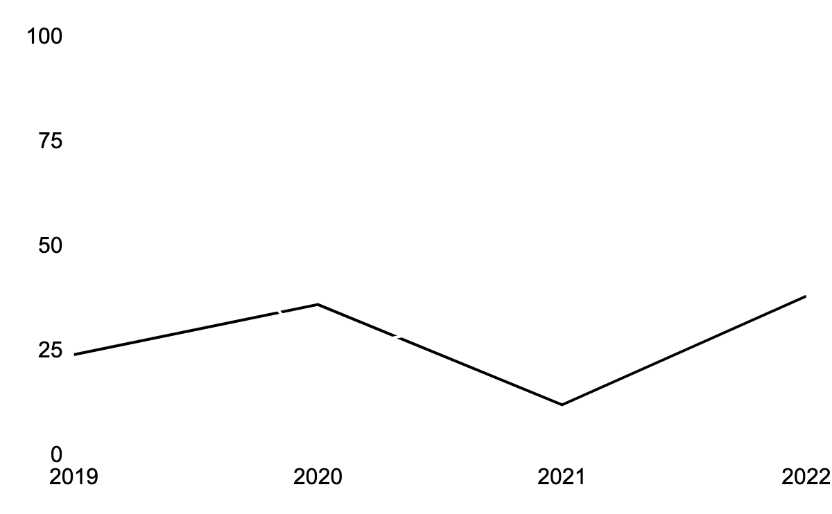
ATTENDANCE IN MAJOR TOURNEYS
VENUS
JUPITER
Venus is the second planet from the Sun
Jupiter is the biggest planet of them all
Follow the link in the graph to modify its data and then paste the new one here. For more info, click here

Slide 29
TOURNAMENT PRIZES
 | TOURNAMENT 1 | TOURNAMENT 2 | TOURNAMENT 3
TOTAL PRIZE POT | $1,200,000 | $980,000 | $855,000
FIRST-PLACE PRIZE | $325,000 | $272,000 | $145,000
PLAYERS IN THE MONEY | 19% | 12% | 7%
TOTAL PLAYERS | 135 | 80 | 62

Slide 30
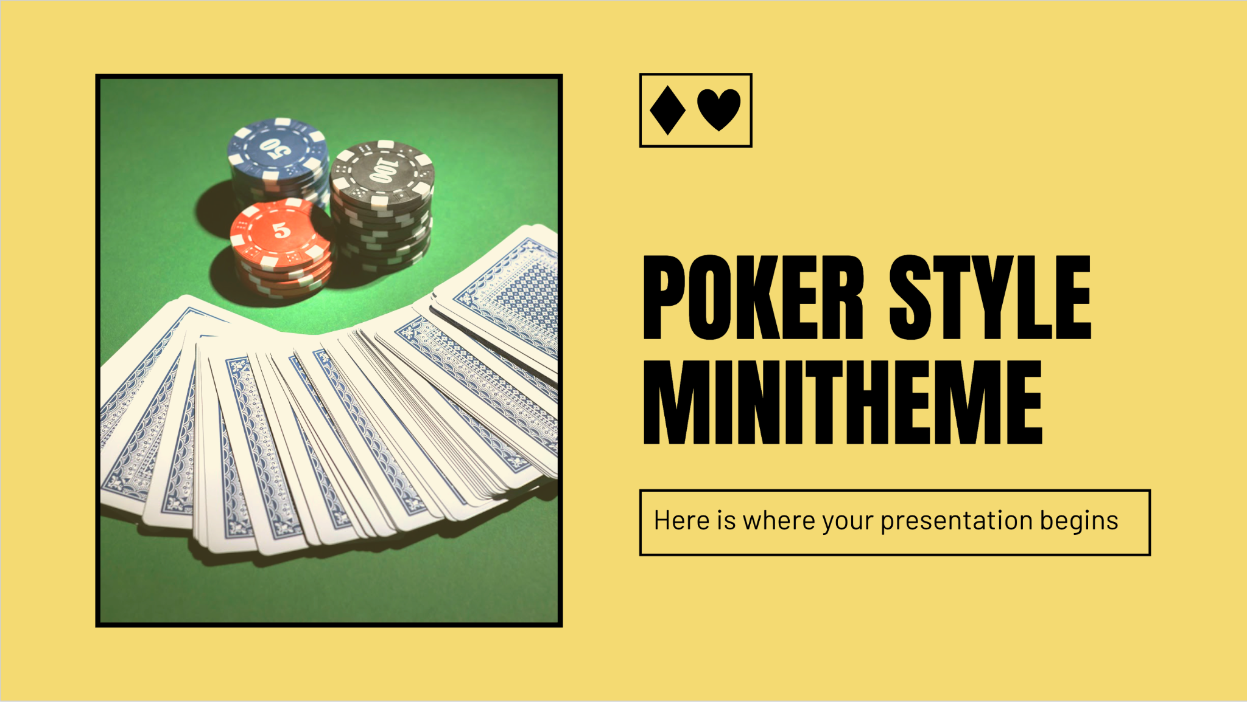
OUR WEBSITE
You can replace the image on the screen with your own work. Just right-click on it and select “Replace image”

Slide 31
DIAGRAM OVERVIEW
K
MERCURY
It’s the closest planet to the Sun
Q
MARS
Mars is actually a very cold place
J
JUPITER
It’s the biggest planet of them all

Slide 32
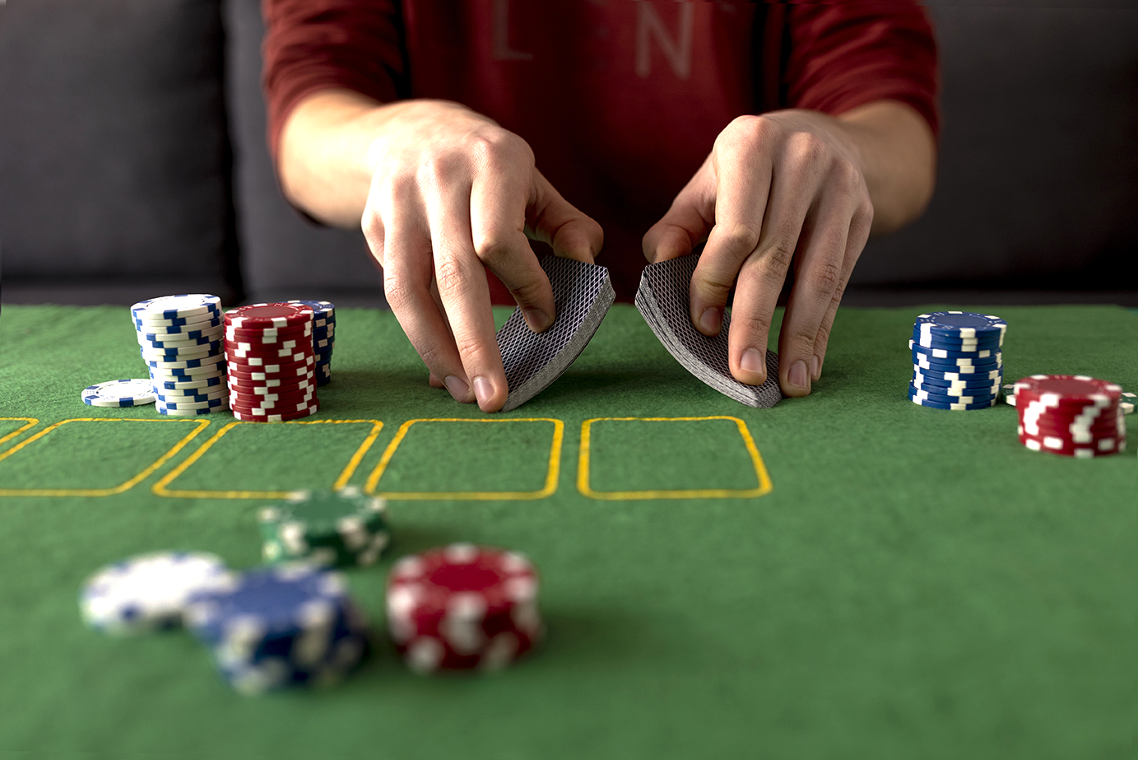
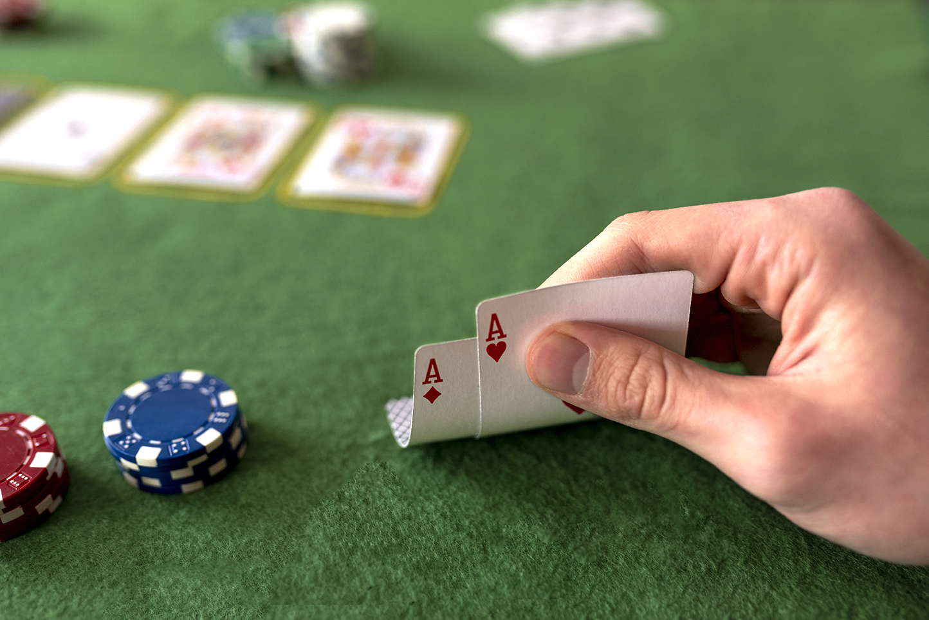
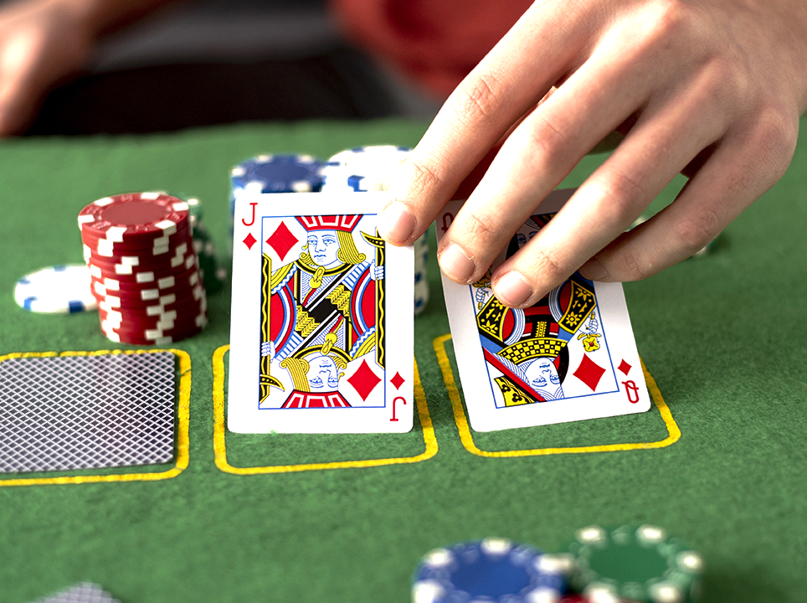
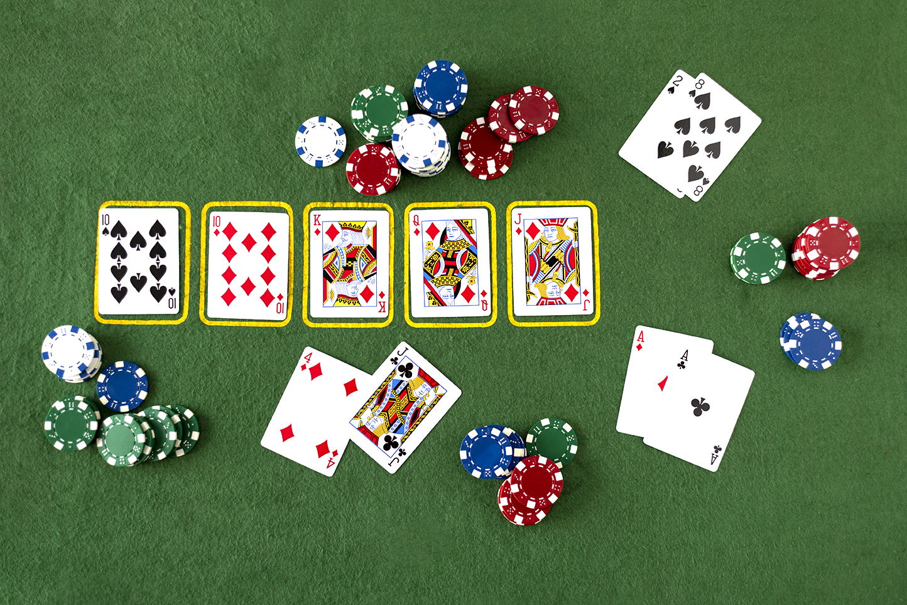
STEPS TO PLAY
VENUS
MARS
Venus is the second planet from the Sun
Despite being red, Mars is a cold place
MERCURY
SATURN
Mercury is the closest planet to the Sun
Saturn is a gas giant and has several rings

Slide 33
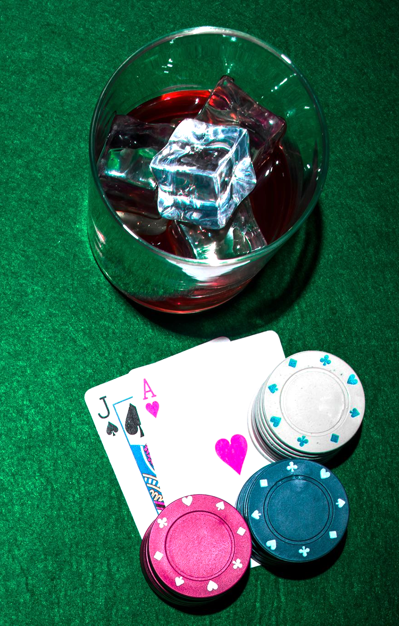
THANKS!
DO YOU HAVE ANY QUESTIONS?
youremail@freepik.com
+91 620 421 838
yourwebsite.com
Please keep this slide for attribution

Slide 34
ICON PACK

Slide 35
ALTERNATIVE RESOURCES
Here’s an assortment of alternative resources whose style fits that of this template:
PHOTOS
Red dices and stack of gambling chips on green poker table
A person holding glass of whiskey while playing poker card
Whisky with ice cubes and casino chips and playing card on green poker table
Jack of spade and heart ace card with casino chips stack on green poker table
Poker player showing jack and ace card with casino chips on green poker table
A person holding glass of whiskey while playing poker card
Whisky with ice cubes and casino chips and playing card on green poker table
Jack of spade and heart ace card with casino chips stack on green poker table

Slide 36
RESOURCES
Did you like the resources on this template? Get them for free at our other websites:
PHOTOS
Stacked casino tokens and royal flush on green background
Casino tokens on green background with ace cards
Royal flush and casino tokens on green background
Royal flush cards with dices on green background
Casino tokens and royal flush
Stacked casino tokens on green background
Deck of cards on green background
Friends having fun while playing poker
Friends having fun while playing poker I
Friends having fun while playing poker II
Friends having fun while playing poker III
Cellphone and whisky glass with jack of spade and heart ace cards on green poker table
Casino tokens on green background with deck of cards
Casino tokens on green background with ace cards
Casino tokens on green background
Casino tokens on green background with blank space
ICONS
Casino filled icon pack

